Slide 1

ROS - Lesson 10
Teaching Assistant: Roi Yehoshua
roiyeho@gmail.com

Slide 2
Agenda
Gazebo 3D simulator
Loading and creating maps in Gazebo
Model SDF files
Gazebo and ROS integration
Using our URDF 3D model in Gazebo

Slide 3
Gazebo
Gazebo is a multi-robot simulator
Like Stage, it is capable of simulating a population of robots, sensors and objects, but does so in a three-dimensional world.
Includes an accurate simulation of rigid-body physics and generates realistic sensor feedback
Allows code designed to operate a physical robot to be executed in an artificial environment
Gazebo is under active development at the Open Source Robotics Foundation (OSRF)

Slide 4
Gazebo Features
Dynamics Simulation
Direct control over physics engine parameters
Building Editor
Construct a 3D model of a building within the Gazebo UI, without writing a line of code
Advanced 3D Graphics
State-of-the-art GPU shaders generate correct lighting and shadows for improved realism.
Sensors
Support for laser range finders, 2D cameras, Kinect style sensors, contact sensors, and RFID sensors

Slide 5
Gazebo Features
Robot Models
Many robots are provided including PR2, iRobot Create, TurtleBot, generic robot arms and grippers
Environments
Access to many objects from simple shapes to terrain
Programmatic Interfaces
Support for ROS
API for custom interfaces

Slide 6
Gazebo Illustrations
PR2 in gazebo opening door
Nao waking in Gazebo

Slide 7
Gazebo Installation
ROS Hydro comes with Gazebo V1.9.1
No need to install anything ☺
Gazebo wiki
http://gazebosim.org/wiki

Slide 8
Gazebo Architecture
Gazebo runs two processes:
Server: Runs the physics loop and generates sensor data.
Executable: gzserver
Libraries: Physics, Sensors, Rendering, Transport
Client: Provides user interaction and visualization of a simulation.
Executable: gzclient
Libraries: Transport, Rendering, GUI

Slide 9
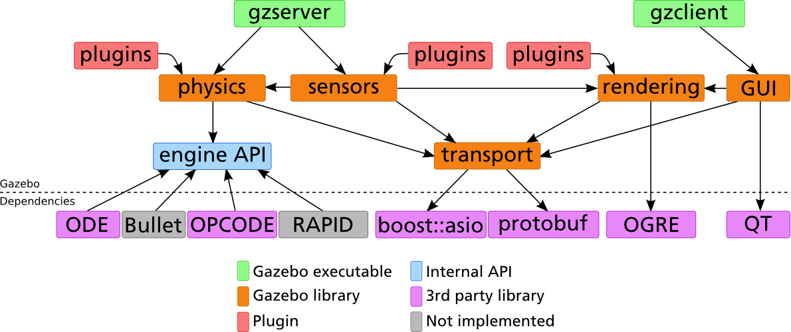
Gazebo Architecture

Slide 10
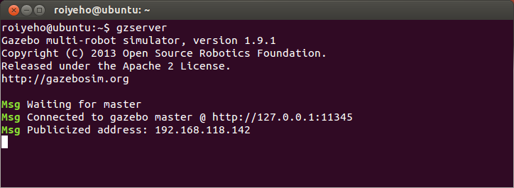
Running Gazebo
To run the Gazebo server type:
This will start the physics engine with an empty world
Expected output:
$ gzserver

Slide 11
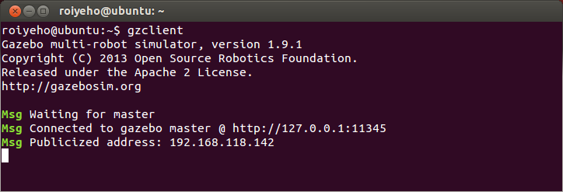
Running Gazebo
To run the Gazebo GUI client type:
This will connect to the server and give you a graphical display of the simulation.
Expected output:
$ gzclient

Slide 12
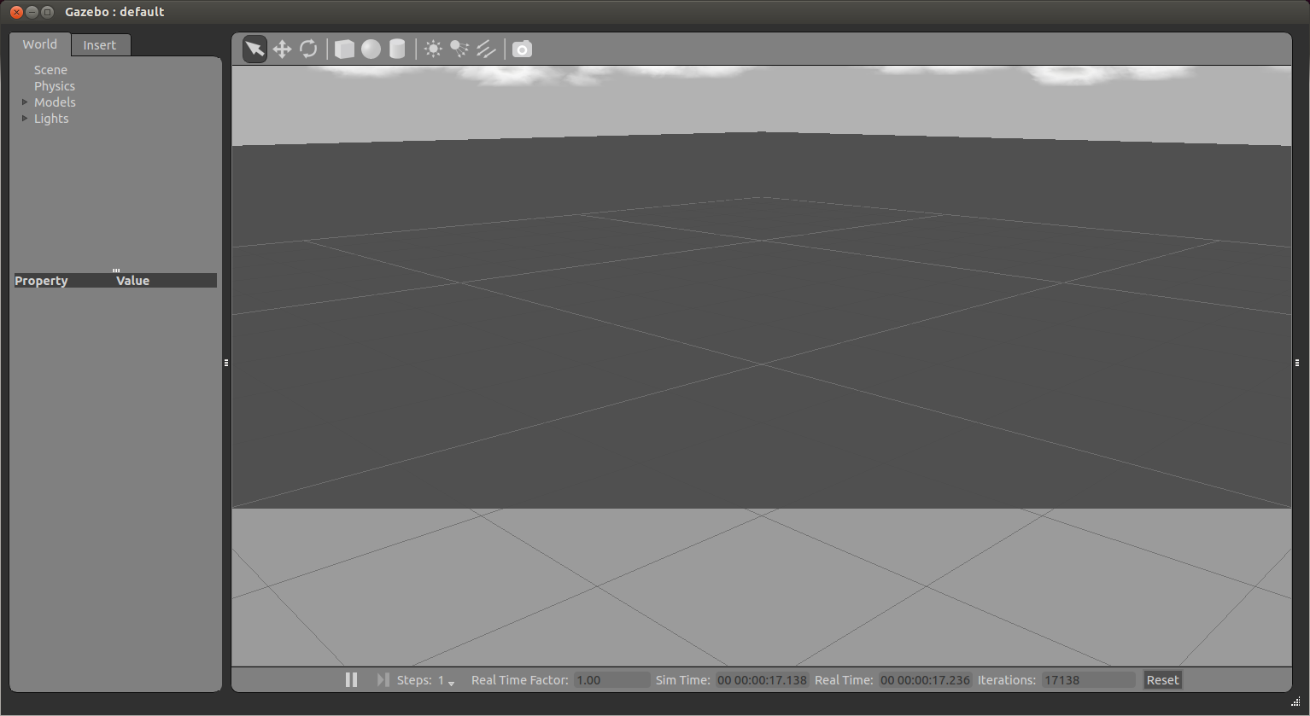
Gazebo Client GUI

Slide 13
Running Gazebo
Alternatively, you can launch the client and the server with a single command:
$ gazebo

Slide 14
Running Gazebo from ROS
To launch both the Gazebo server and GUI:
To launch only the client:
To launch only the server:
$ rosrun gazebo_ros gazebo
$ rosrun gazebo_ros gui
$ rosrun gazebo_ros gzserver

Slide 15
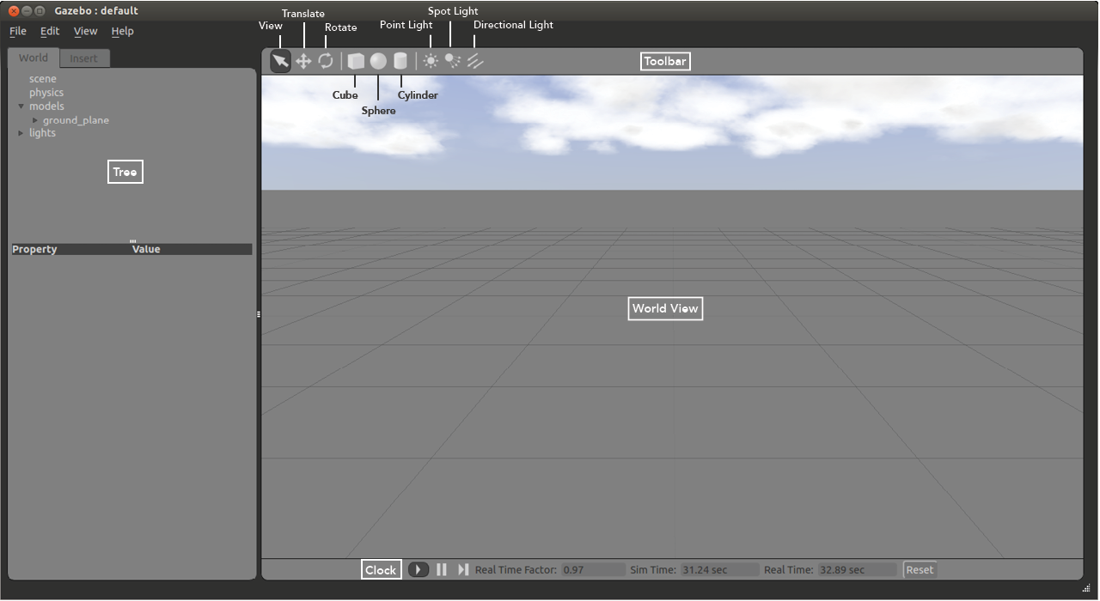
Gazebo User Interface

Slide 16
The World View
The World View displays the world and all of the models therein.
Here you can add, manipulate, and remove models.
You can switch between View, Translate and Rotate modes of the world view in the left side of the Toolbar
In View Mode you can navigate around the world by panning, orbiting and zooming.
Translate Mode lets users translate an object
Rotate Mode lets you rotate an object.

Slide 17
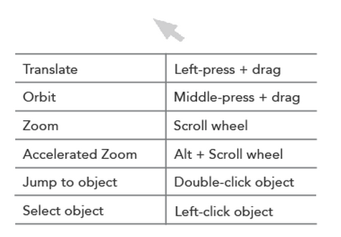
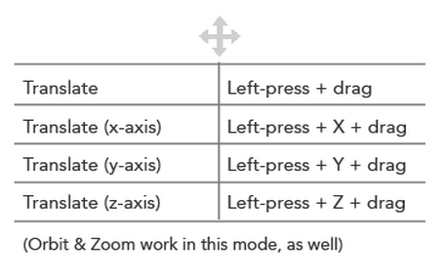
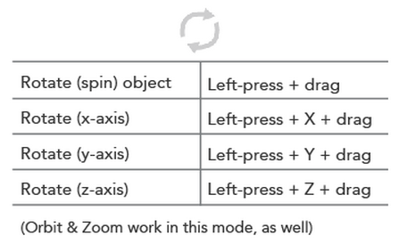
World View Shortcuts
View Mode
Translate Mode
Rotate Mode

Slide 18
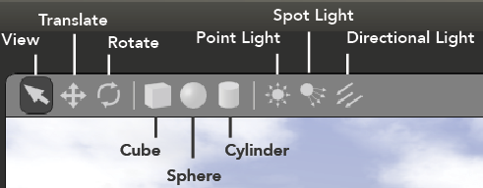
Toolbar
The Toolbar provides tools with which to navigate and manipulate the world.
The Cube, Sphere and Cylinder icons let users add these simple shapes to the world.
The Point Light, Spot Light and Directional Light icons allow users to insert light into the world.

Slide 19
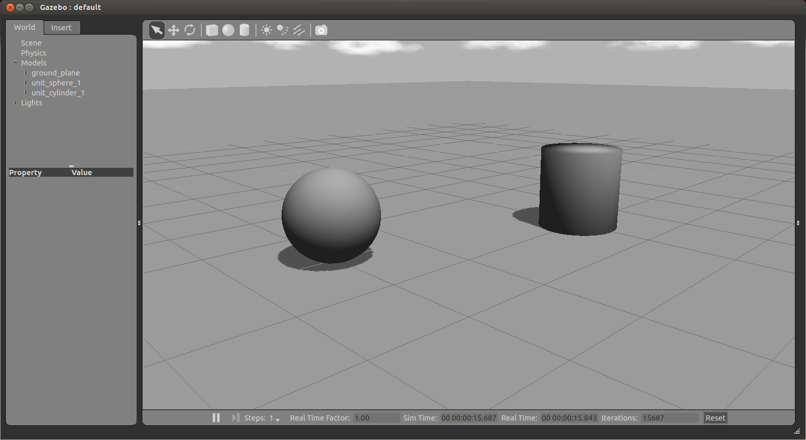
Adding Shapes

Slide 20
The Tree
The Tree lists the models in the world, and allows users to change a variety of parameters for most models.
The Tree is also where users can add new models to the world.
The Tree consists of the World and Insert tabs.

Slide 21
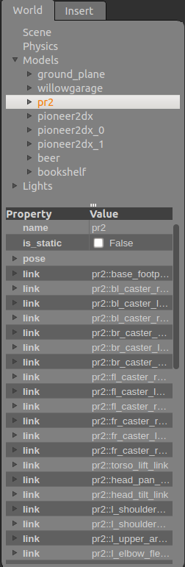
The World Tab
This tab is divided into Scene, Physics, Models, and Lights.
Each section contains relevant parameters that can be altered by the user.
These parameters appear in the bottom half of the Tree when an item is selected.

Slide 22
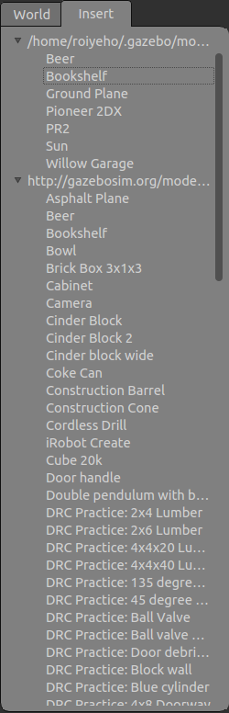
The Insert Tab
Displays all of the models available for use in Gazebo.
The first directory is your directory of local models.
The second directory is the Gazebo model database.
Once a model has been inserted from here, it will appear in the local directory as well.

Slide 23
The Insert Tab
To add a model to the world:
left-click on the desired model in the Insert Tab
move the cursor to the desired location in World View.
left-click again to release.
Use the Translate and Rotate modes to orient the model more precisely.

Slide 24
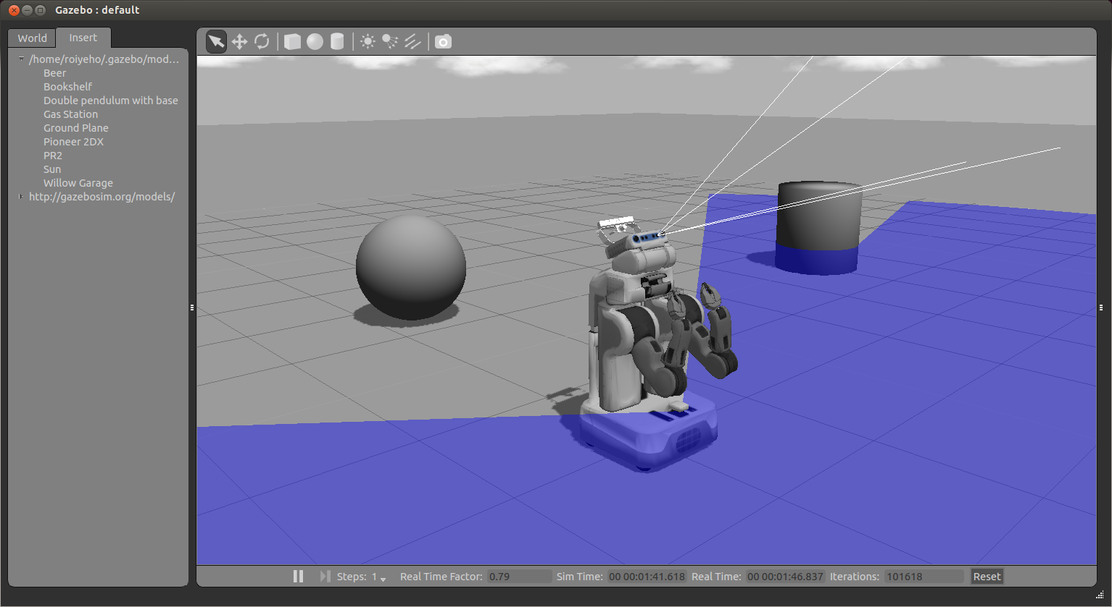
Inserting PR2 Robot

Slide 25
Models Item
The models item in the world tab contains a list of all models and their links.
Right-clicking on a model in the Models section gives you three options:
Move to – moves the view to be directly in front of that model
Follow
View – allows you to view different aspects of the model, such as Wireframe, Collisions, Joints
Delete – deletes the model

Slide 26
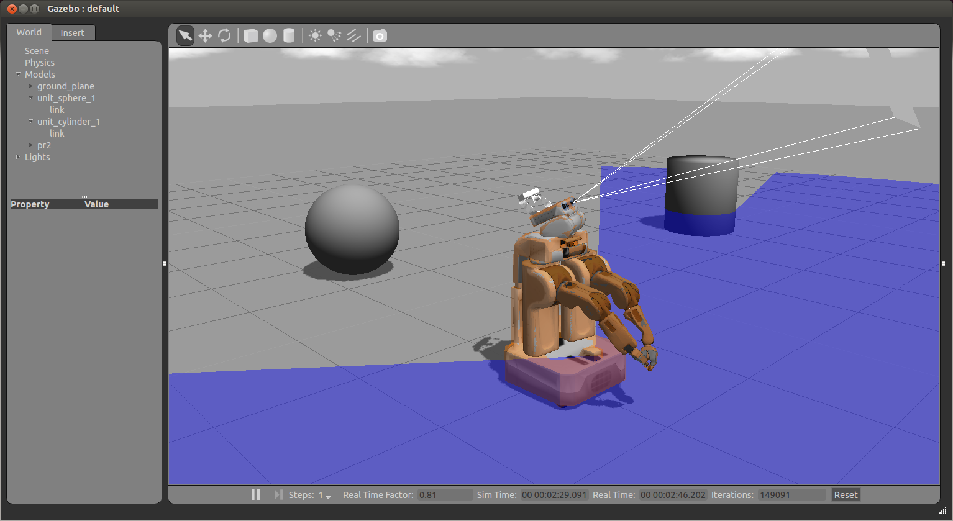
Collisions View

Slide 27
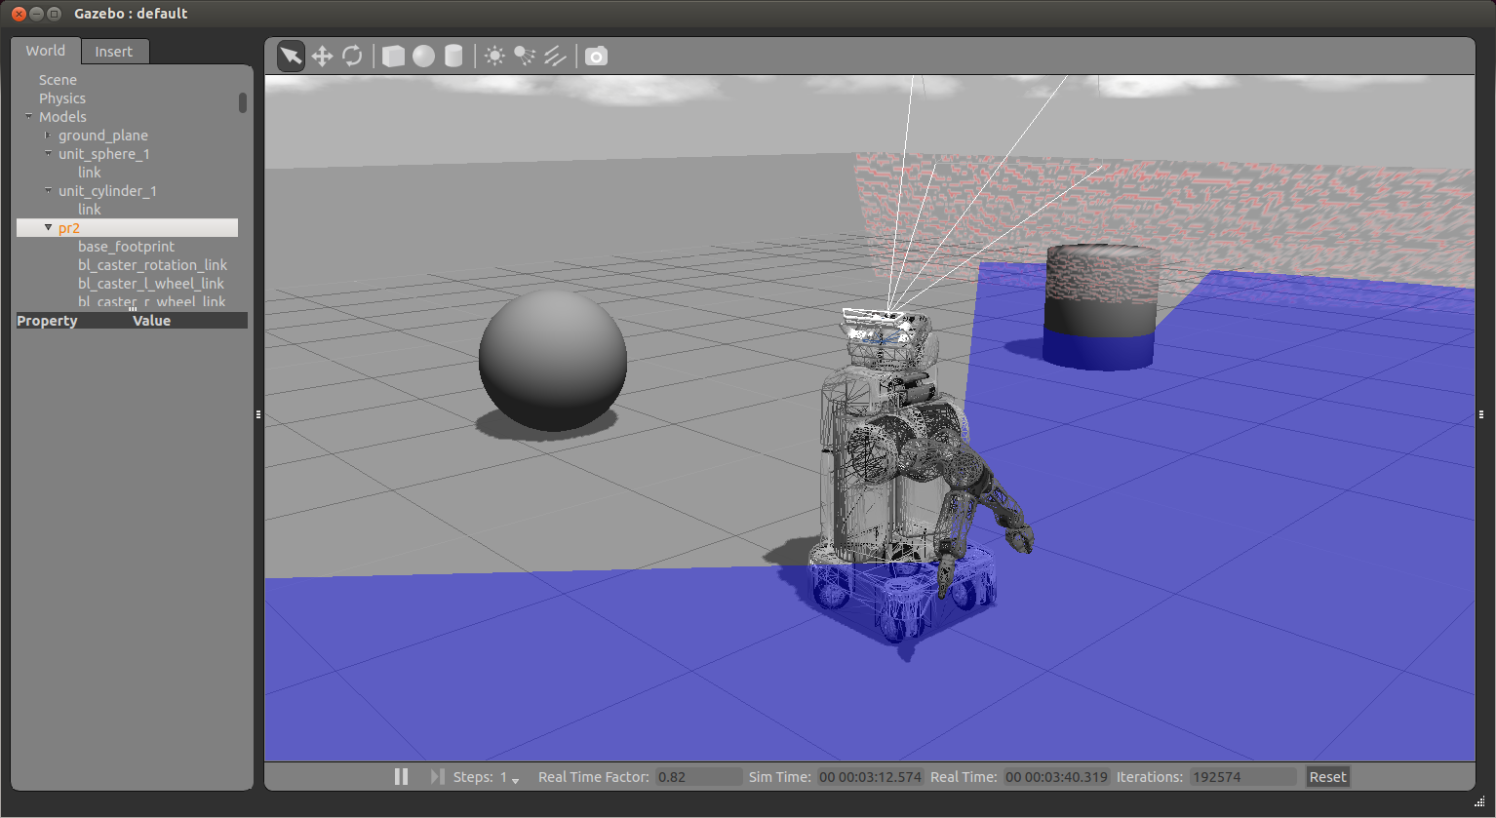
Wireframe View

Slide 28

Clock
You can start, pause and step through the simulation with the clock, located at the bottom of the World View.
Real Time Factor: Displays how fast or slow the simulation is running in comparison to real time.
A factor less than 1.0 indicates simulation is running slower than real time, and greater then 1.0 indicates faster than real time.

Slide 29
Useful Menu Options
File –> Save World As: Saves the current world to file
Edit –> Reset Model Poses: Resets all models to their position when they were first inserted
Edit –> Reset World: Resets model poses AND time
View –> Grid: Checking/unchecking this reveals/hides the grid on the ground plane
View –> Reset View: Returns the view to a default view
View –> Full Screen: Puts the World View into fullscreen (To exit fullscreen mode, press F11)

Slide 30
Building Editor
The Building Editor allows you to create models of multi-level buildings without writing any code.
Buildings can contain doorways, windows and stairs.
To access the Building Editor, go to the Edit menu and select Building Editor.
At the end of the construction process, the Building Creator creates an SDF file so that the model can be used in Gazebo.

Slide 31
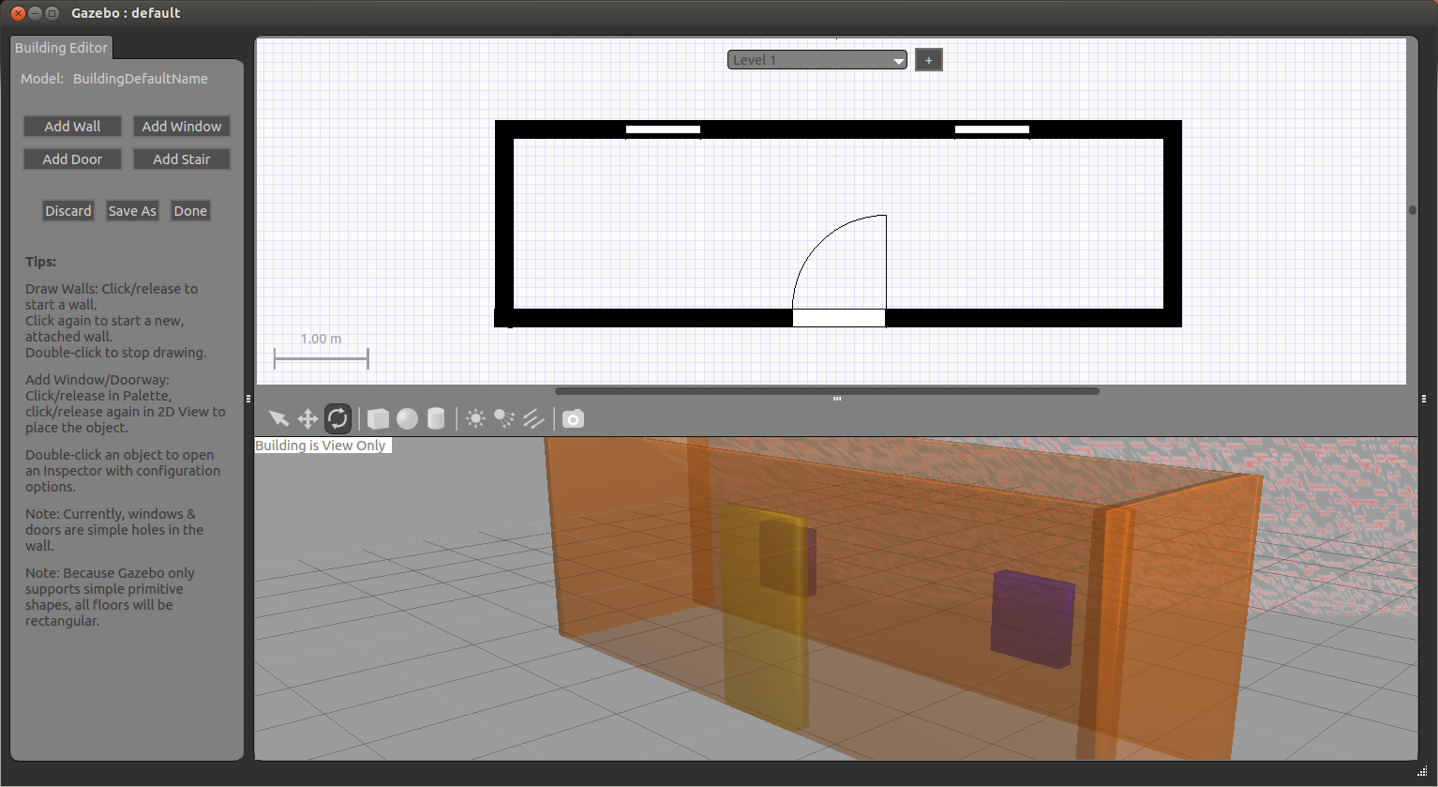
Building Editor

Slide 32
Finishing a Building
When you are done creating your building, select Done in the Palette.
The Building Editor will close and your new building will be placed into the world.

Slide 33
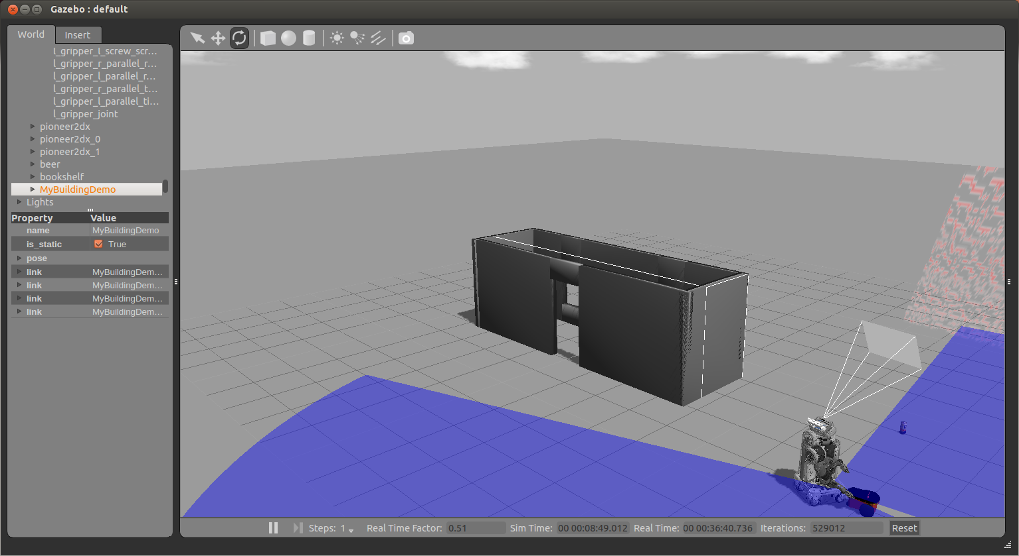
Finishing a Building

Slide 34
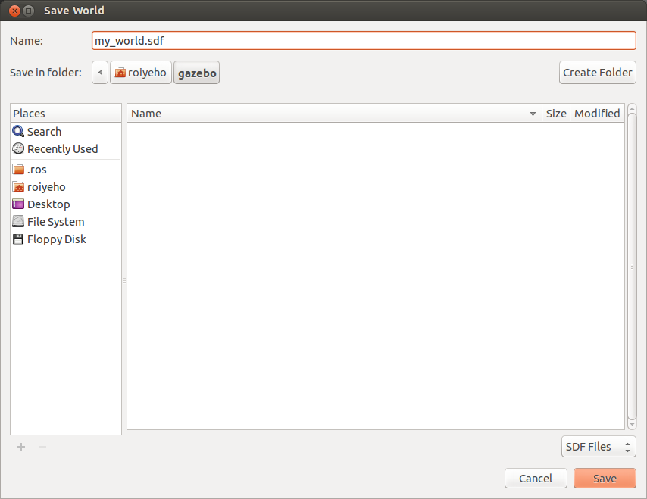
Saving a World
Once you are happy with a world it can be saved through the File->Save As menu.
Enter my_world.sdf as the file name and click OK

Slide 35
Loading a World
A saved world may be loaded on the command line:
The filename must be in the current working directory, or you must specify the complete path.
$ gazebo my_world.sdf

Slide 36
World Description File
The world description file contains all the elements in a simulation, including robots, lights, sensors, and static objects.
This file is formatted using SDF (Simulation Description format), and has a .world extension
The Gazebo server (gzserver) reads this file to generate and populate a world.

Slide 37
Simulation Description Format (SDF)
SDF is an XML file that contains a complete description for everything from the world level down to the robot level, including:
Scene: Ambient lighting, sky properties, shadows.
Physics: Gravity, time step, physics engine.
Models: Collection of links, collision objects, joints, and sensors.
Lights: Point, spot, and directional light sources.
Plugins: World, model, sensor, and system plugins.
http://gazebosim.org/sdf.html

Slide 38
SDF vs URDF
URDF can only specify the kinematic and dynamic properties of a single robot in isolation.
URDF can not specify the pose of the robot itself within a world.
Cannot specify joint loops (parallel linkages)
Lacks friction and other properties.
Additionally, it cannot specify things that are not robots, such as lights, heightmaps, etc.
SDF is a complete description for everything from the world level down to the robot level. It is scalable, and makes it easy to add and modify elements.

Slide 39
Example World Files
A number of example worlds are shipped with Gazebo.
World files are found within the /worlds directory of your Gazebo resource path.
A typical path might be /usr/local/share/gazebo-1.9
You can use roslaunch to open world models
For example, to open willowgarage_world type:
$ roslaunch gazebo_ros willowgarage_world.launch

Slide 40
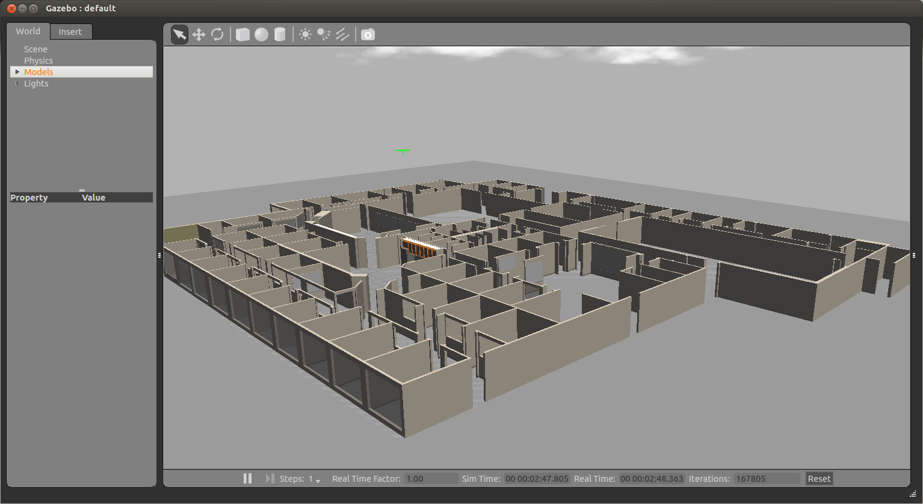
Willow Garage World

Slide 41
willowgarage_world.launch
<launch>
<!-- We resume the logic in empty_world.launch, changing only the name of the world to be launched -->
<include file="$(find gazebo_ros)/launch/empty_world.launch">
<arg name="world_name" value="worlds/willowgarage.world"/> <!-- Note: the world_name is with respect to GAZEBO_RESOURCE_PATH environmental variable -->
<arg name="paused" value="false"/>
<arg name="use_sim_time" value="true"/>
<arg name="gui" value="true"/>
<arg name="headless" value="false"/>
<arg name="debug" value="false"/>
</include>
</launch>
In this launch file we inherit most of the necessary functionality from empty_world.launch.
The only parameter we need to change is the world_name parameter, substituting the empty.world world file with willowgarage.world.
The other arguments are simply set to their default values.

Slide 42
willowgarage.world
<?xml version="1.0" ?>
<sdf version="1.4">
<world name="default">
<include>
<uri>model://ground_plane</uri>
</include>
<include>
<uri>model://sun</uri>
</include>
<include>
<uri>model://willowgarage</uri>
</include>
</world>
</sdf>
In this world file snippet you can see that three models are referenced.
The three models are searched for within your local Gazebo Model Database. If not found there, they are automatically pulled from Gazebo's online database.

Slide 43
Gazebo Models
Models in Gazebo define a physical entity with dynamic, kinematic, and visual properties.
Models can range from simple shapes to complex robots
Even the ground is a model

Slide 44
Components of Models
Links: A link contains the physical properties of one body of the model. This can be a wheel, or a link in a joint chain.
Each link may contain many collision, visual and sensor elements
Collision: A collision element encapsulates a geometry that is used to collision checking.
This can be a simple shape (which is preferred), or a triangle mesh (which consumes greater resources).
Visual: A visual element is used to visualize parts of a link.
Inertial: The inertial element describes the dynamic properties of the link, such as mass and rotational inertia matrix.
Sensor: A sensor collects data from the world for use in plugins.
Joints: A joint connects two links.
A parent and child relationship is established along with other parameters such as axis of rotation, and joint limits.
Plugins: A shared library created by a 3D party to control a model.

Slide 45
Model Files
A model file uses the same SDF format as world files, but should only contain a single <model>.
Once a model file is created, it can be included in a world file using the following SDF syntax:
This facilitates model reuse, and simplify world files.
A number of models are provided in the online model database
You can include any model from the database and the necessary content will be downloaded at runtime.
<include filename="model_file_name"/>

Slide 46
willowgarage Model SDF File
<?xml version="1.0" ?>
<sdf version="1.4">
<model name="willowgarage">
<static>true</static>
<pose>-20 -20 0 0 0 0</pose>
<link name="walls">
<collision name="collision">
<geometry>
<mesh>
<uri>model://willowgarage/meshes/willowgarage_collision.dae</uri>
</mesh>
</geometry>
</collision>
<visual name="visual">
<geometry>
<mesh>
<uri>model://willowgarage/meshes/willowgarage_visual.dae</uri>
</mesh>
</geometry>
<cast_shadows>false</cast_shadows>
</visual>
</link>
</model>
</sdf>

Slide 47
Gazebo + ROS Integartion
The set of ROS packages for interfacing with Gazebo are contained within a meta package named gazebo_ros_pkgs
This package provides the necessary interfaces to simulate a robot in Gazebo using ROS messages, services and dynamic reconfigure.

Slide 48
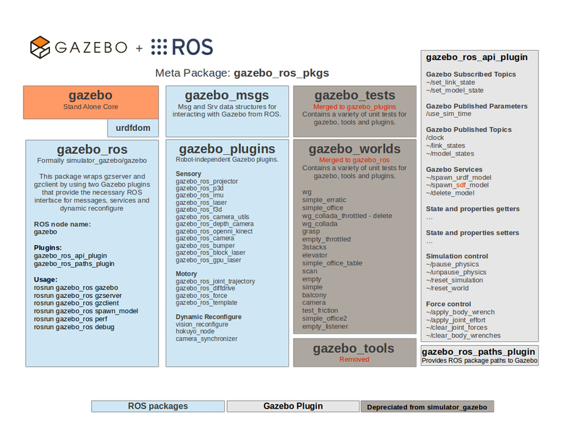
Gazebo + ROS Integration

Slide 49
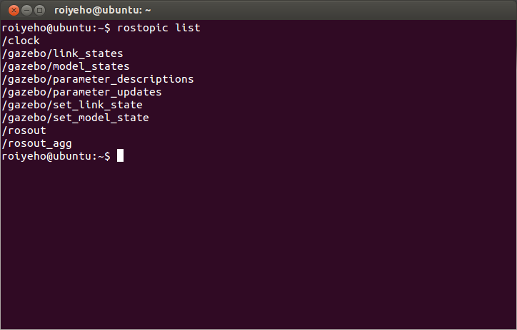
Gazebo ROS Topics

Slide 50
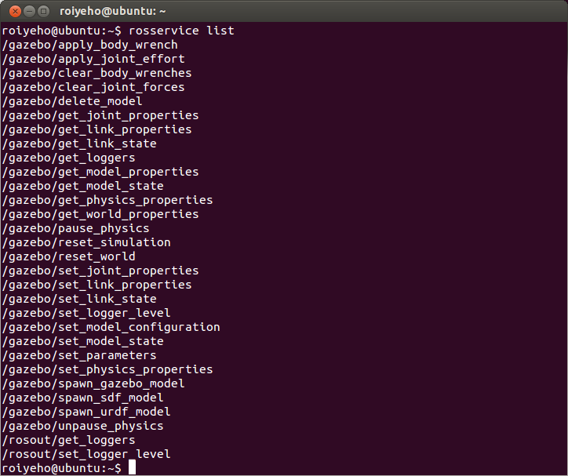
Gazebo ROS Services

Slide 51
Creating a Gazebo ROS Package
The robot's model and description are located in a package named /MYROBOT_description
The world and launch files used with Gazebo is located in a package named /MYROBOT_gazebo
Replace MYROBOT with the name of your robot or something like “test” if you don’t have one

Slide 52
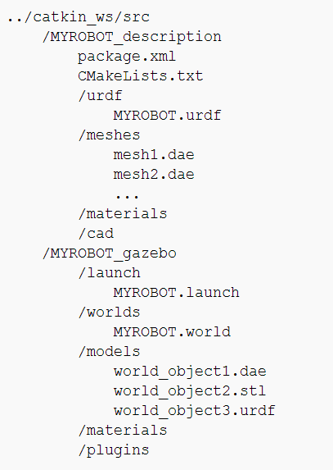
Creating a Gazebo ROS Package
The package hierarchy should be as follows:

Slide 53
Creating a Custom World File
In the following tutorial we'll make an empty world with a ground, a sun, a gas station and an r2d2 robot
Create ROS packages r2d2_gazebo and r2d2_description:
Within the r2d2_gazebo package, create a launch folder
In the launch folder create a r2d2.launch file with the following contents
$ cd ~/catkin_ws
$ catkin_create_pkg r2d2_gazebo
$ catkin_create_pkg r2d2_description

Slide 54
r2d2.launch
<launch>
<!-- We resume the logic in empty_world.launch, changing only the name of the world to be launched -->
<include file="$(find gazebo_ros)/launch/empty_world.launch">
<arg name="world_name" value="$(find r2d2_gazebo)/worlds/r2d2.world"/>
<!-- more default parameters can be changed here -->
</include>
</launch>

Slide 55
Creating a Custom World File
Within the same package, create a worlds folder, and create a r2d2.world file with the following:
<?xml version="1.0" ?>
<sdf version="1.4">
<world name="default">
<include>
<uri>model://ground_plane</uri>
</include>
<include>
<uri>model://sun</uri>
</include>
<include>
<uri>model://gas_station</uri>
<name>gas_station</name>
<pose>-2.0 7.0 0 0 0 0</pose>
</include>
</world>
</sdf>

Slide 56
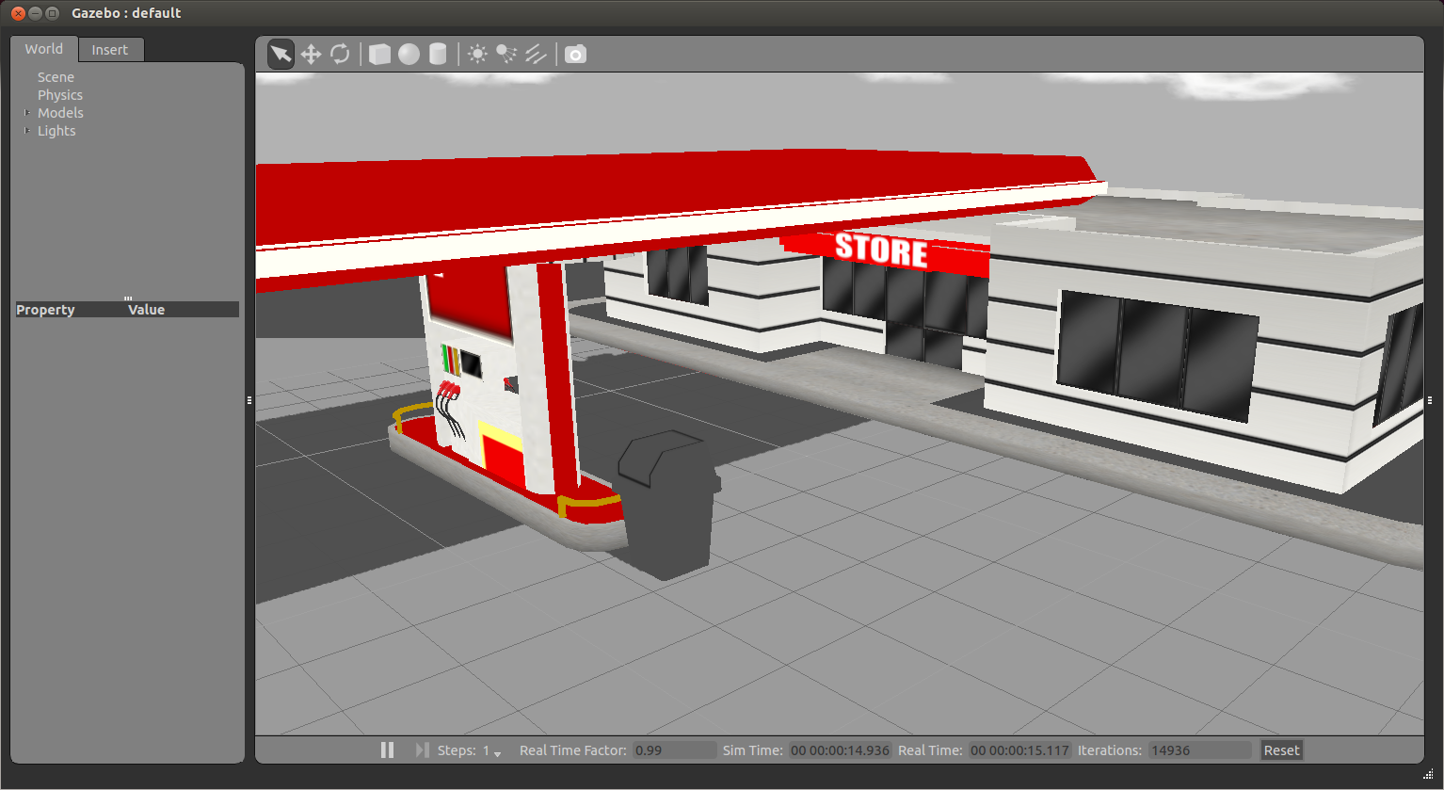
Creating a Custom World File
You should now be able to launch your custom world into Gazebo using the following command:
$ roslaunch r2d2_gazebo r2d2.launch

Slide 57
Spawn URDF Robots
Within the r2d2_description package, create a urdf folder, and copy 07-physics.urdf from the urdf_tutorial package
$ cp 07-physics.urdf ~/catkin_ws/src/r2d2_description/urdf/r2d2.urdf

Slide 58
Spawn URDF Robots
There are two ways to launch your URDF-based robot into Gazebo using roslaunch:
ROS Service Call Spawn Method - Keeps your robot’s model separate from the .world file, but also requires you to make a ROS service call using a small script.
This is the recommended method
Model Database Method - Allows you to include your robot within the .world file, which seems cleaner and more convenient but requires you to add your robot to the Gazebo model database by setting an environment variable.

Slide 59
Spawn URDF Robots
We will use a spawn_model located at the gazebo_ros package to make a service call request to the gazebo ROS node to add a custom URDF into Gazebo.
You can use this script in the following way:
$ rosrun gazebo_ros spawn_model -file `rospack find r2d2_description`/urdf/r2d2.urdf -urdf -x 0 -y 0 -z 1 -model r2d2

Slide 60
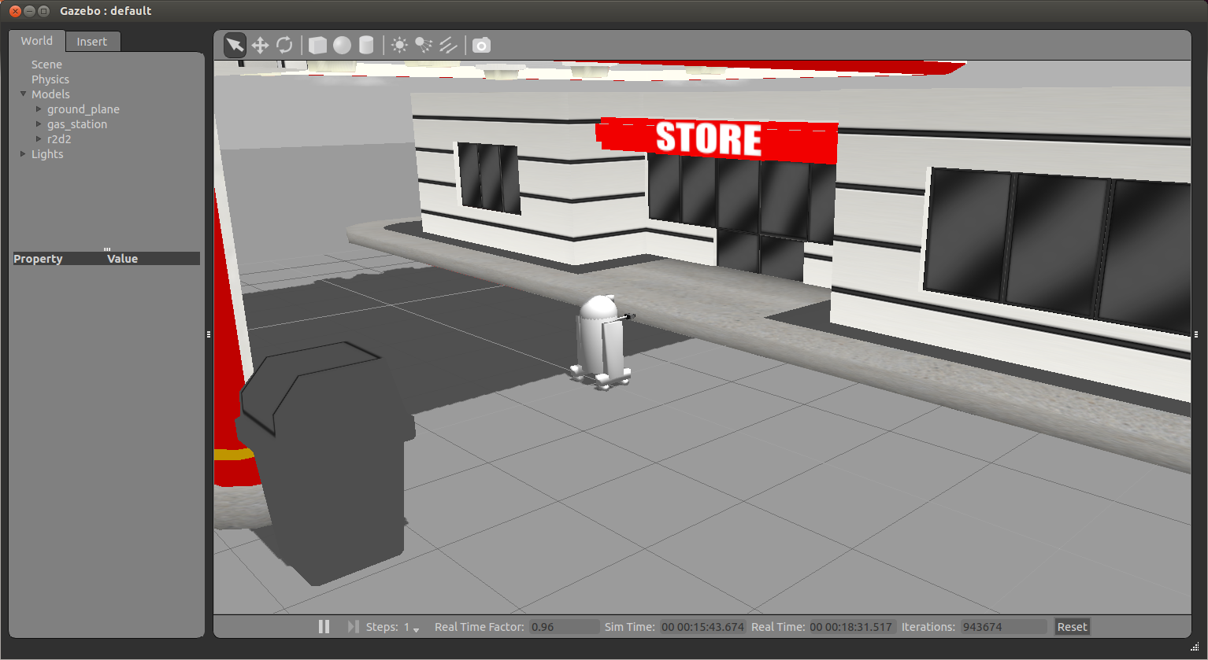
Spawn URDF Robots

Slide 61
Spawn URDF Robots
To integrate this directly into a ROS launch file, reopen the file r2d2_gazebo/launch/r2d2.launch and add the following before the </launch> tag:
Launching this file, you should see the same results as when using rosrun.
<!-- Spawn a robot into Gazebo -->
<node name="spawn_urdf" pkg="gazebo_ros" type="spawn_model" args="-file $(find r2d2_description)/urdf/r2d2.urdf -urdf -z 1 -model r2d2" />

Slide 62
XACRO Example with PR2
If your URDF is not in XML format but rather in XACRO format, you can make a similar modification to your launch file.
You can spawn a PR2 robot by adding the following to the launch file:
<!-- Convert an xacro and put on parameter server -->
<param name="robot_description" command="$(find xacro)/xacro.py $(find pr2_description)/robots/pr2.urdf.xacro" />
<!-- Spawn a PR2 robot into Gazebo -->
<node name="spawn_pr2_urdf" pkg="gazebo_ros" type="spawn_model" args="-param robot_description -urdf -x 2 -model pr2" />

Slide 63
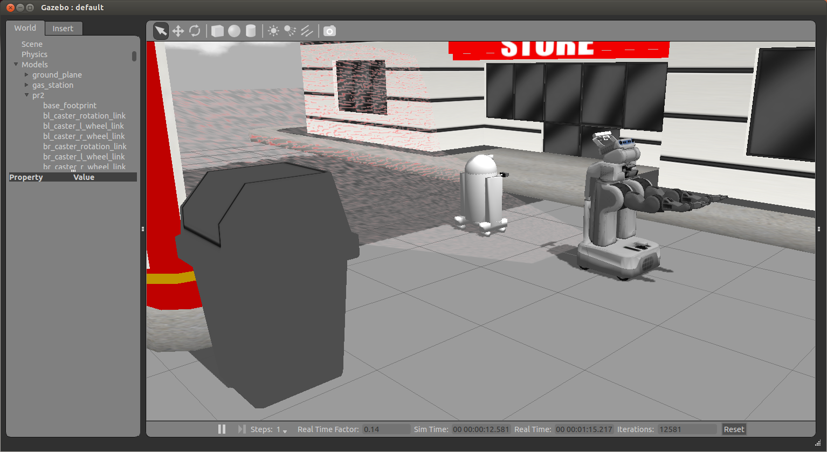
XACRO Example with PR2

Slide 64
Using URDF In Gazebo
To use a URDF file in Gazebo, some additional simulation-specific tags must be added to work properly with Gazebo.
Adding these tags saves you from having to create a separate SDF file from scratch and duplicating description formats
Under the hood, Gazebo converts the URDF to SDF automatically.

Slide 65
Using URDF In Gazebo
Required
An <inertia> element within each <link> element must be properly specified and configured.
Optional
Add a <gazebo> element for every <link>
Convert visual colors to Gazebo format
Convert stl files to dae files for better textures
Add sensor plugins
Add a <gazebo> element for every <joint>
Set proper damping dynamics
Add actuator control plugins
Add a <gazebo> element for the <robot> element
Add a <link name="world"/> link if the robot should be rigidly attached to the world/base_link

Slide 66
The <gazebo> Element
The <gazebo> element is an extension to the URDF used for specifying additional properties needed for simulation purposes in Gazebo.
It allows you to specify the properties found in the SDF format that are not by default in the URDF format.
None of the elements within a <gazebo> element are required because default values will be automatically included.
There are 3 types of <gazebo> elements - for the <robot>, <link> tags, and <joint> tags.

Slide 67
<gazebo> element for <robot> tag
You can add a <gazebo> element for the <robot> tag with the attribute static
If set to true, the model is immovable. Otherwise the model is simulated in the dynamics engine.
All objects which are not meant to move should be marked as static, which is a performance enhancement.

Slide 68
Links
The <visual> and <collision> tags work essentially the same in Gazebo as in Rviz.
It’s important that you specify both though, because unlike some ROS applications, Gazebo will not use your <visual> elements as <collision> elements if you do not explicitly specify a <collision> element.
Instead, Gazebo will treat your link as "invisible" to laser scanners and collision checking.

Slide 69
Adding Materials
A standard URDF can specify colors in the link:
This method of specifying link colors does not work in Gazebo. Instead, a Gazebo material tag must be specified for each link, such as:
<link name="base_link">
<visual>
<material name="blue">
<color rgba="0 0 .8 1"/>
</material>
</visual>
</link>
<gazebo reference="base_link">
<material>Gazebo/Blue</material>
</gazebo>

Slide 70
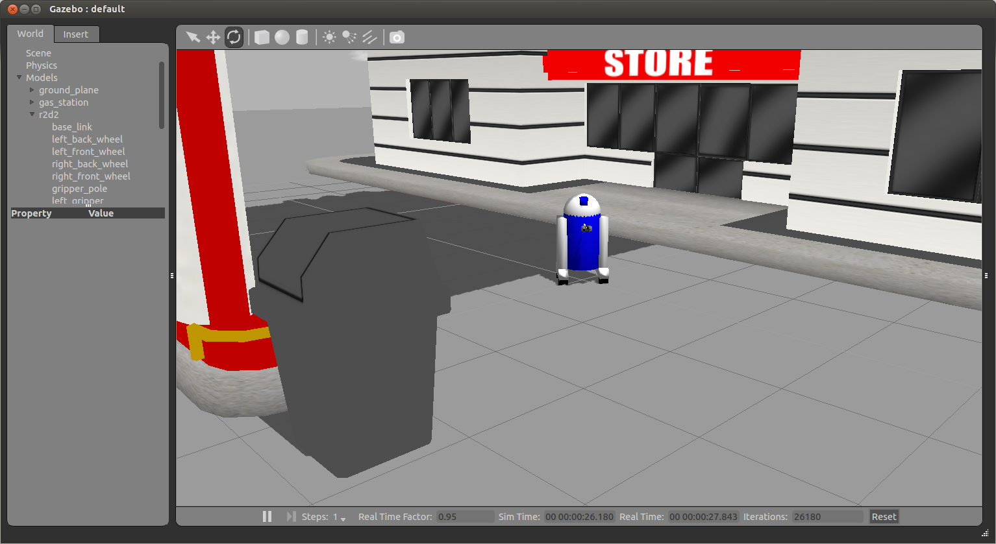
Adding Materials

Slide 71
Adding Materials
The default available materials in Gazebo can be found in the Gazebo source code at /usr/share/gazebo-1.9/ media/materials/scripts/gazebo.material

Slide 72
Joints
Not all of the elements documented for URDF joints are applicable to Gazebo:
The <origin>, <parent> and <child> are required
<calibration> and <safety_controller> are ignored
In the <dynamics> tag, only the damping property is used
All of properties in the <limit> tag are optional

Slide 73
Verifying the Gazebo Model
An easy tool exists to check if your URDF can be properly converted into a SDF.
Simply run the following command:
This will show you the SDF that has been generated from your input URDF as well as any warnings about missing information required to generate the SDF.
$ gzsdf print r2d2.urdf

Slide 74
r2d2.sdf
<sdf version='1.4'>
<model name='physics'>
<link name='base_link'>
<pose>0 0 0 0 -0 0</pose>
<inertial>
<pose>0 0 -0.04 0 -0 0</pose>
<mass>50</mass>
<inertia>
<ixx>8.62</ixx>
<ixy>0</ixy>
<ixz>0</ixz>
<iyy>10.556</iyy>
<iyz>0</iyz>
<izz>6.936</izz>
</inertia>
</inertial>
….

Slide 75
Homework (not for submission)
Create a custom world file in Gazebo
Spawn the URDF model of the robot that you created in the previous lesson in this world

